Slide 1
Multivariate Analysis PCA
Pimonrat Tiansawat

Slide 2
Objectives: students should be able
To describe common terminology in multivariate analysis lessons
To describe how principal components analysis work

Slide 3

Examples of multivariate data sets
Type | PW | PL | SW | SL
0 | 2 | 14 | 33 | 50
1 | 24 | 56 | 31 | 67
1 | 23 | 51 | 31 | 69
0 | 2 | 10 | 36 | 46
1 | 20 | 52 | 30 | 65
1 | 19 | 51 | 27 | 58
2 | 13 | 45 | 28 | 57
2 | 16 | 47 | 33 | 63
1 | 17 | 45 | 25 | 49
2 | 14 | 47 | 32 | 70
0 | 2 | 16 | 31 | 48
1 | 19 | 50 | 25 | 63
0 | 1 | 14 | 36 | 49
0 | 2 | 13 | 32 | 44
2 | 12 | 40 | 26 | 58
1 | 18 | 49 | 27 | 63
2 | 10 | 33 | 23 | 50
0 | 2 | 16 | 38 | 51
Type = 0-2 = 3 species of Iris
Measurement
Petal width
Petal length
Sepal width
Sepal length
150 observations
(Anderson’s data
published by
Fisher 1936)

Slide 4
Mean dry weight of 54 plant species on 89 plots and covariates
plot | lime | species | hay | pH | TO | TP | TR | VC | VK
1 | 1 | 33 | 5.105 | 7 | 0.1 | 0.04 | 0 | 0 | 0 | …..
1 | 2 | 31 | 6.455 | 6.2 | 0.14 | 0 | 0 | 0 | 0
1 | 3 | 33 | 4.87 | 5.3 | 0.02 | 0.06 | 0 | 0 | 0
1 | 4 | 10 | 2.16 | 4 | 0 | 0 | 0 | 0 | 0
2.1 | 1 | 42 | 4.62 | 7 | 0.08 | 0.68 | 0.48 | 0.01 | 0
2.1 | 2 | 37 | 5.85 | 6 | 0.4 | 0.28 | 0.03 | 0 | 0
2.1 | 3 | 33 | 4.055 | 5.1 | 0.03 | 0.03 | 0 | 0 | 0
2.1 | 4 | 33 | 4.46 | 5 | 0 | 0 | 0 | 0 | 0
3 | 1 | 39 | 4.5 | 7.1 | 0.07 | 0.65 | 0.05 | 0.02 | 0
3 | 2 | 36 | 5.58 | 6.5 | 0.31 | 0.48 | 0.06 | 0 | 0
3 | 3 | 37 | 4.275 | 5.4 | 0.03 | 0.04 | 0 | 0 | 0
3 | 4 | 36 | 5.235 | 5.2 | 0.03 | 0.01 | 0 | 0 | 0
4.1 | 1 | 34 | 5.725 | 6.8 | 0.1 | 2.78 | 0.02 | 0.06 | 0
4.1 | 2 | 34 | 6.06 | 6.2 | 0.11 | 1.09 | 0.03 | 0.04 | 0
. | . | . | . | . | . | . | . | . | .

Slide 5
Two main categories
Dependence: y= f(x)
Interdependence: f(x, y) = 0
A dependent variable y or a set of dependent variables (>1) is explained by x.
e.g.
Multiple ANOVA (MANOVA),
Multivariate discriminant analysis,
Multiple regression*,
Structural equations model,
Conjoint analysis,
Canonical correlation analysis
etc.
Simultaneous analysis of variables without distinction between dependent and independent variables
e.g.
Principal component analysis (PCA)
Cluster analysis
Multidimensional scaling
Correspondence analysis
etc.
We will learn this one.

Slide 6
What multivariate techniques look for?
Structure in data
Categories or groups of objects
Producing hypotheses to prepare further studies

Slide 7
Ordination
The ordering or arranging of sampling units among any number of dimensions or gradients
Often reduce dimensionality to 2-3 axes
Reduce noise
Reduce redundancy

Slide 8
Ordination as data reduction
Summarize a data set containing many variables into a smaller number of composite (synthetic) variables

Slide 9
Principal Component Analysis: PCA
One of the most popular exploratory analyses
Technique to find a small number of linear combinations of the variables to capture most of the variation in the data set
X₁, X₂, X₃,…, X_{n} → C₁, C₂, C₃,…, C_{p}
where p < n

Slide 10
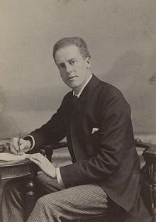
PCA
Karl Pearson 1901
“On Lines and Planes
of Closets Fit to
Systems of Points
in Space”

Slide 11
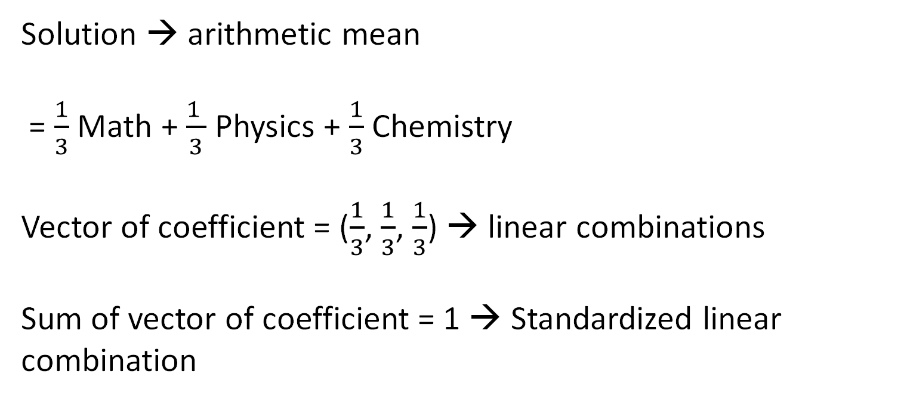
Student | Math | Physics | Chemistry | Performance
1 | 10 | 7 | 8 | ?
2 | 9 | 10 | 5 | ?
3 | 10 | 6 | 10 | ?
Solution → arithmetic mean
= $\frac{1}{3}$ Math + $\frac{1 }{3}$ Physics + $\frac{1}{3}$ Chemistry
Vector of coefficient = ($\frac{1}{3}$, $\frac{1}{3}$, $\frac{1}{3}$) → linear combinations
Sum of vector of coefficient = 1 → Standardized linear combination

Slide 12
When to use
To reduce the dataset to have fewer dimensions and to preserve as much information as possible.
Data with approximately linear relationship among variables
Sample size
Tabachinik and Fidell 1989 proposed at least 5 sample units
Tabachinik and Fidell 1996 → 100 of sample units
Bottom line – weak correlation structure → larger sample size

Slide 13
Steps
Standardize the continuous initial variables
Compute the covariance matrix (correlation)
Compute the eigenvectors and eigenvalues of the covariance matrix
Create a feature vector to decide which principal components to keep
Recast the data along the principal component axes
Zakaria Jaadi - https://builtin.com/data-science/step-step-explanation-principal-component-analysis

Slide 14
PCA → finds a set of standardized orthogonal linear combinations
Aim = explain all of the variation in the original data sets
Variables → X₁, X₂, …, X_{n}
Principal Components
C₁ = a₁₁X₁+a₁₂X₂ +…+ a_{1n}X_{n}
C₂ = a₂₁X₁+a₂₂X₂ +…+ a_{2n}X_{n}
…….

Slide 15
{a₁₁,a₁₂,...,a_{1n}} is 1st Eigenvector of correlation/covariance matrix, and coefficients of first principal component
{a₂₁,a₂₂,...,a_{2n}} is 2nd Eigenvector of correlation/covariance matrix, and coefficients of 2nd principal component

Slide 16
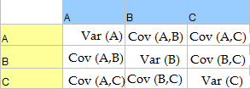
Variance-covariance matrix (Covariance matrix)
Var(A) = [Σ ( A_{i} - A )²] / N
Cov (A,B) = = [Σ ( A_{i} - A ) ( B_{i} - B )]/ N
Notes:
http://www.statisticshowto.com/wp-content/uploads/2015/09/variance-covariance-matrix-2.png

Slide 17
Correlation matrix
corr(A, B) = Cov (A, B)
sd(A) sd(B)
sd(A) = standard deviation of A
sd(B) = standard deviation of B

Slide 18
PCA is either performed on a variance–covariance matrix or on a correlation matrix.
Covariance Matrix:
Variables must be in same units
Emphasizes variables with most variance
Mean eigenvalue ≠1.0
Correlation Matrix:
Variables are standardized (mean 0.0, SD 1.0)
Variables can be in different units
All variables have same impact on analysis
Mean eigenvalue = 1.0

Slide 19
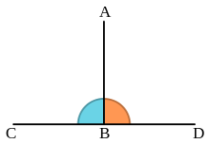
Orthogonal
Perpendicular
Independent

Slide 20
2nd Principal
Component, C₂
1st Principal
Component, C₁
Notes:
S. Narasimhan 2010

Slide 21
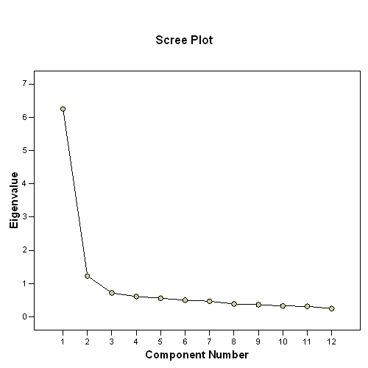
How many PCs to retain?
Scree plot
Notes:
http://www.janda.org/workshop/factor%20analysis/SPSS%20run/SPSS08.gif

Slide 22
How many PCs to retain?
Kaiser Rule
- keep PCs with eigenvalues >1
The amount of variance that is accounted for by the principal components (PCs)
= Enough PCs to have a cumulative variance explained by the PCs that is >50-70%

Slide 23
